Slide 1
App Rating Prediction
Google Play Store — Course-End Project 1
10,841
7,307
13
Total Apps
After Cleaning
Features
Domain: General | Technique: Linear Regression | Target: App Rating (1–5)

Slide 2
Problem Statement & Objective
Business Context
Objective
Google Play Store is launching a new feature to boost promising apps - increasing their visibility in:
• Recommendations (Similar apps, You might also like)
• New & updated game sections
• Search result rankings
This feature helps newer apps with potential reach wider audiences.
Predict which apps will have high ratings so Google can identify and promote promising apps.
Key Insight:
App ratings (provided by customers) are a strong indicator of app quality and user satisfaction.
ML Task:
Regression — predict the numerical rating of an app based on its features.
Dataset: googleplaystore.csv | 12 Steps to Solution

Slide 3
Dataset Overview — 13 Features
App
Text
Price
Numeric
Application name
App price in USD
Category
Categorical
Content Rating
Categorical
App category (FAMILY, GAME…)
Age group targeted
Rating ★
Target
Genres
Categorical
Overall user rating (1–5)
Multiple genres per app
Reviews
Numeric
Last Updated
Date
Number of user reviews
Last update date on Play Store
Size
Numeric
Current Ver
Text
App size (KB / MB)
Current version of the app
Installs
Numeric
Android Ver
Text
Number of downloads
Min required Android version
Type
Categorical
Free or Paid

Slide 4
Data Preprocessing Pipeline
1
Null Value Removal
4
Outlier Removal
Rating: 1474 | Type: 1 | Content Rating: 1 | Android Ver: 3 → Drop all rows with nulls
Price > $200 dropped | Reviews > 2M dropped | Installs > 10,000,000 dropped
2
Type Fixing
5
Log Transformation
Size (Mb→×1000 KB) | Reviews → int | Installs (remove +,) → int | Price (remove $) → float
np.log1p() applied to Reviews and Installs — reduces right skew before modeling
3
Sanity Checks
6
Feature Engineering
Rating ∈ [1,5] | Reviews ≤ Installs | Free apps: Price = 0 → Drop violations
Drop: App, Last Updated, Current Ver, Android Ver | Dummy encode: Category, Genres, Content Rating → inp2

Slide 5
Data Cleaning — Results & Sanity Checks
10,841
3,534
7,307
32.6%
Original Records
Records Removed
Clean Records
Data Removed
Null Values by Column
Sanity Check Rules
Column | Null Count
Rating | 1,474
Type | 1
Content Rating | 1
Current Ver | 8
Android Ver | 3
App / Category / Reviews / Installs | 0
✓ Rating must be between 1 and 5
✓ Reviews ≤ Installs (can't review without installing)
✓ Free apps must have Price = 0
✓ Price > $200 → treated as junk, dropped
✓ Reviews > 2,000,000 → star app, dropped
✓ Installs > 10,000,000 → dropped (docx threshold)

Slide 6
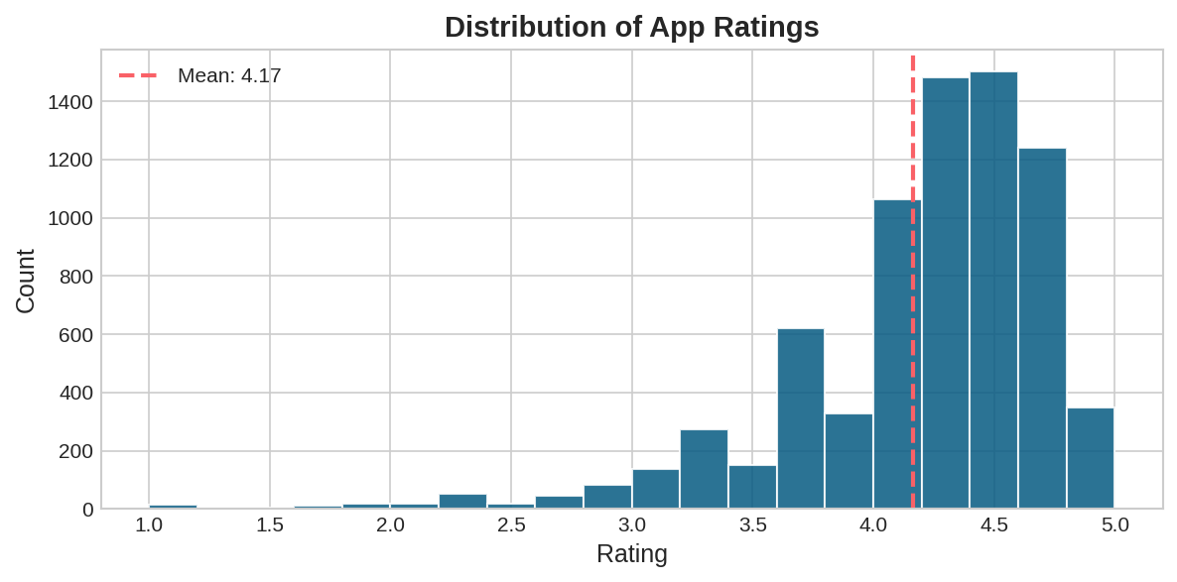
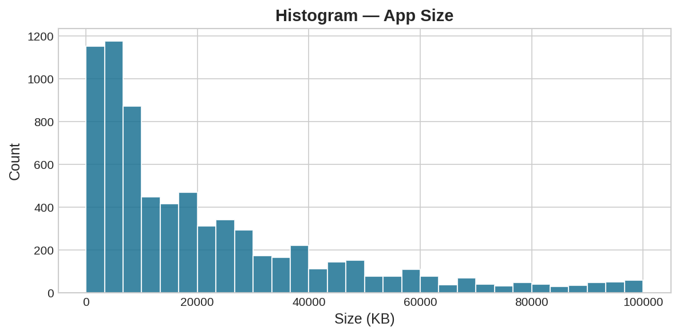
Univariate Analysis — Rating & Size
Rating Distribution
App Size Distribution
📊 Rating: Left-skewed — most apps rated 4.0–5.0. Mean = 4.17, Median = 4.30. 📦 Size: Right-skewed — most apps are small (<50 MB). A few very large apps are outliers.

Slide 7
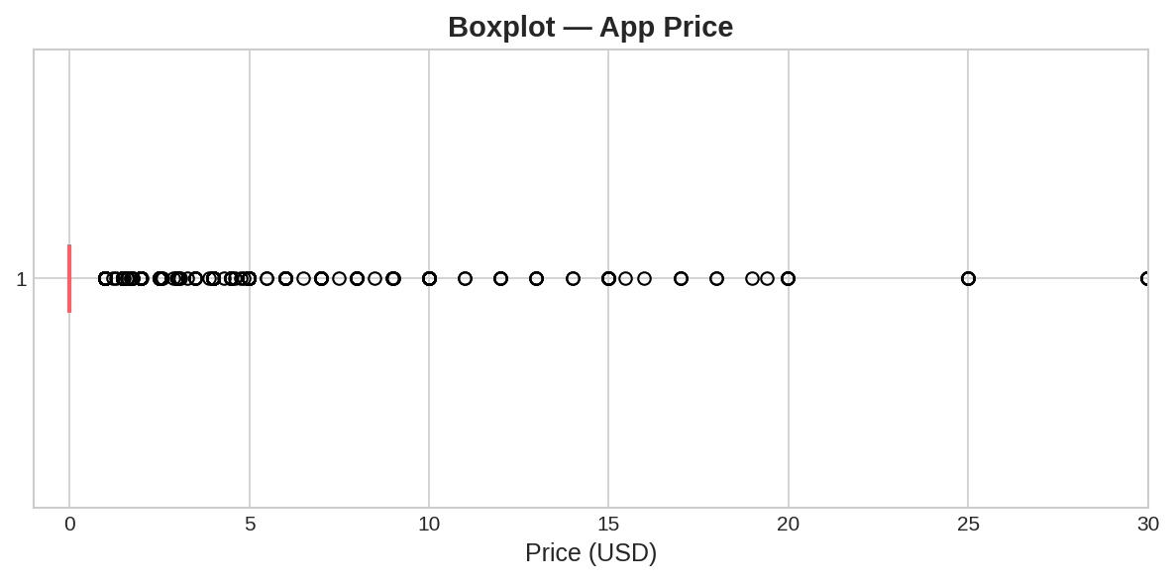
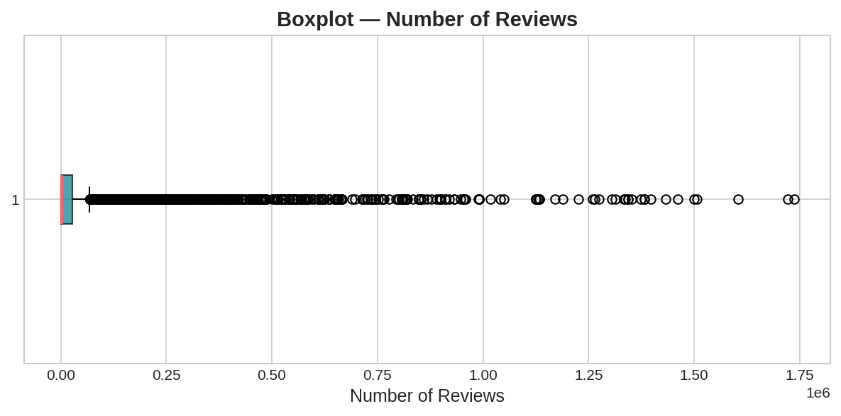
Univariate Analysis — Price & Reviews Boxplots
Boxplot — Price
Boxplot — Reviews
💰 Price: Most apps are FREE or very low cost. Apps >$200 are clear outliers (junk apps) → dropped.
⭐ Reviews: Extremely right-skewed. A few apps have millions of reviews — star apps that skew the analysis → dropped.

Slide 8
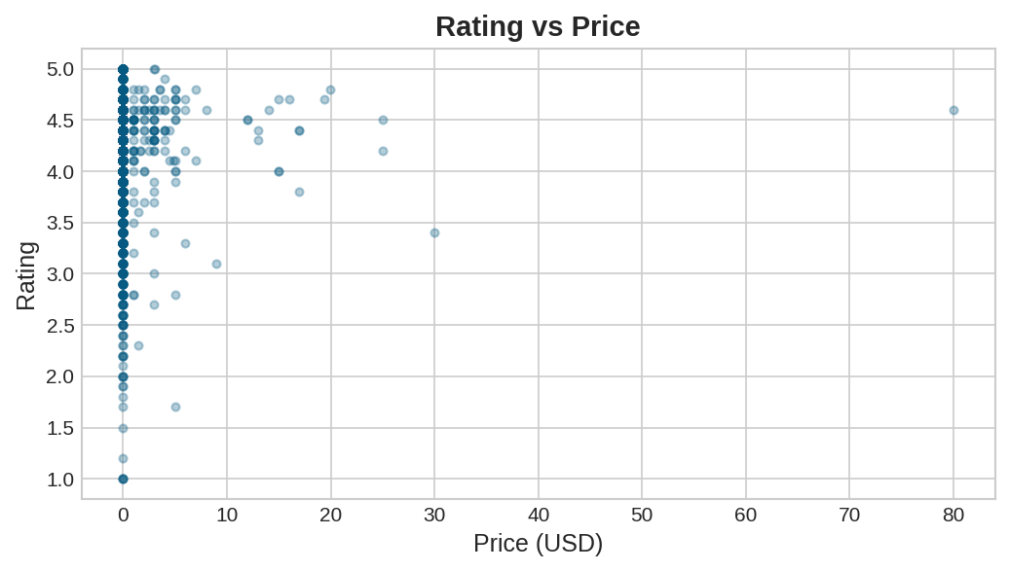
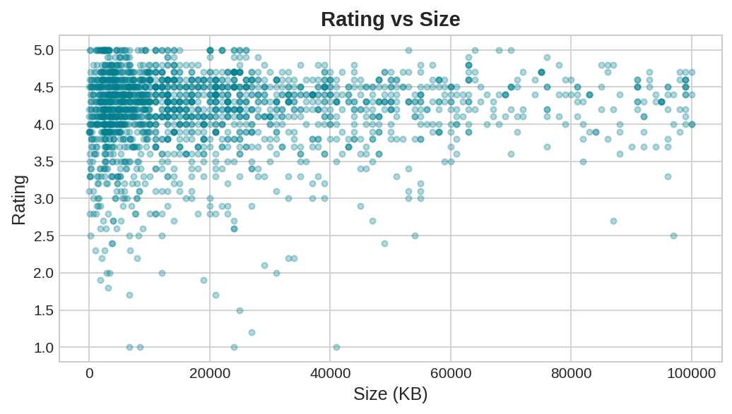
Bivariate Analysis — Rating vs Price & Size
Rating vs Price
Rating vs Size
💸 Price vs Rating: No clear pattern. Free apps dominate. Paid apps show slight rating increase, but the relationship is very weak.
📦 Size vs Rating: No strong correlation. Heavier apps are not necessarily rated better. Size alone is a poor predictor of rating.

Slide 9
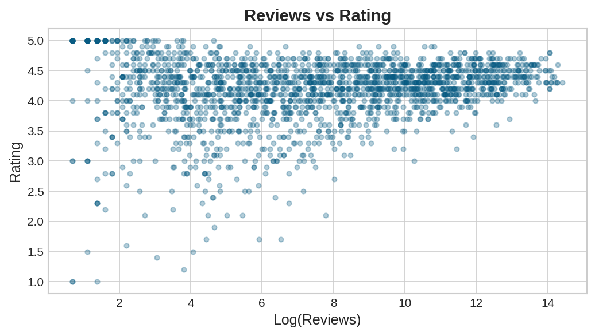
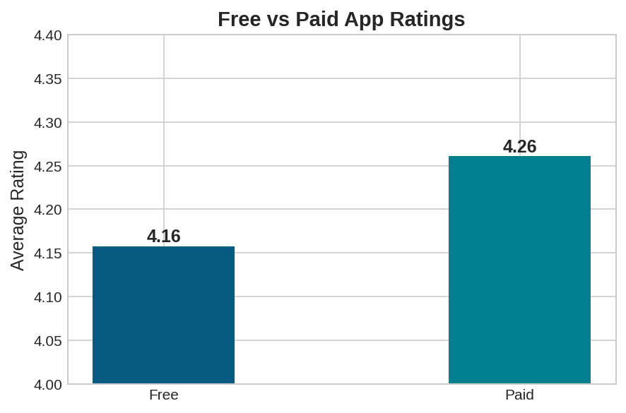
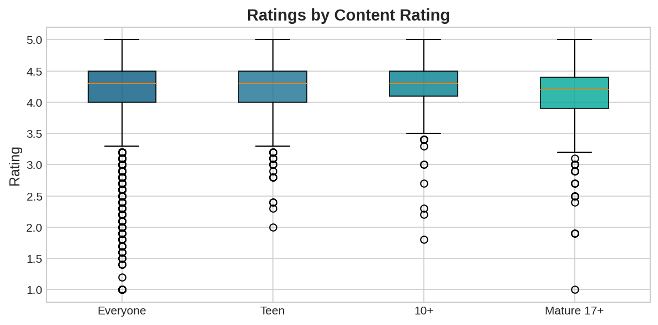
Bivariate Analysis — Reviews, Type & Content Rating
Rating vs Reviews (log)
Free vs Paid
Content Rating
Key Observations
📊 Reviews vs Rating: Weak correlation. More reviews don't guarantee a higher rating.
💰 Paid apps (avg 4.26) rated slightly higher than Free (4.16) — higher user commitment.
👨‍👩‍👧 Adults-only apps have the highest avg rating. 'Everyone' category shows the most variance.

Slide 10
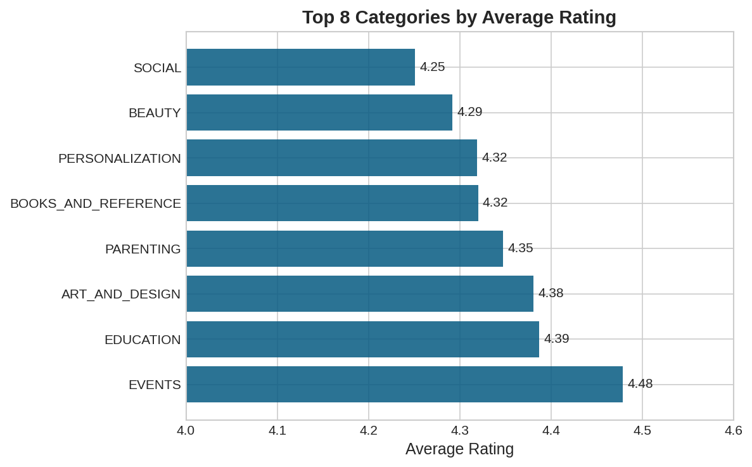
Bivariate Analysis — Ratings by Category
Top Category Insights
EVENTS
★ 4.48
EDUCATION
★ 4.39
ART & DESIGN
★ 4.38
PARENTING
★ 4.35
BOOKS & REF
★ 4.32
EVENTS and EDUCATION apps consistently receive the highest ratings — prime candidates for Google's promotion feature.

Slide 11
Key Code Snippets
Step 1–3: Load & Clean
Step 8: Preprocessing (inp1 → inp2)
df = pd.read_csv('googleplaystore.csv')
df.dropna(inplace=True)
df['Size'] = df['Size'].apply(lambda x: float(x.replace('M',''))*1000
if 'M' in str(x) else float(x.replace('k','')))
df['Reviews'] = df['Reviews'].apply(lambda x: int(x))
df['Installs'] = df['Installs'].str.replace('[+,]','').apply(int)
df['Price'] = df['Price'].str.replace('$','').apply(float)
inp1 = df.copy()
inp1['Reviews'] = np.log1p(inp1['Reviews'])
inp1['Installs'] = np.log1p(inp1['Installs'])
inp1.drop(['App','Last Updated','Current Ver','Android Ver'], axis=1, inplace=True)
inp2 = pd.get_dummies(inp1, columns=['Category','Genres','Content Rating'])
Step 5–6: Sanity + Outlier Removal
Step 9–12: Split & Model
df = df[(df['Rating']>=1) & (df['Rating']<=5)]
df.drop(df[df['Reviews']>df['Installs']].index, inplace=True)
df.drop(df[df['Price']>200].index, inplace=True)
df.drop(df[df['Reviews']>2000000].index, inplace=True)
df.drop(df[df['Installs']>10000000].index, inplace=True)
X = inp2.drop('Rating', axis=1)
y = inp2['Rating']
X_train, X_test, y_train, y_test = train_test_split(X, y, test_size=0.3, random_state=5)
lin_reg = LinearRegression()
lin_reg.fit(X_train, y_train)
print('Train R2:', round(lin_reg.score(X_train, y_train),3))
print('Test R2:', round(lin_reg.score(X_test, y_test), 3))

Slide 12
Model Building — Linear Regression Results
Raw Data
Preprocessing
& Cleaning
Feature
Engineering
Train/Test
Split 70/30
Linear
Regression
Evaluation
(R²)
Model Configuration
Model Performance (R²)
Algorithm:
Linear Regression (sklearn)
Train R²
Train Size:
70% → df_train
0.109
Test Size:
30% → df_test
Target Variable:
Rating (continuous, 1–5)
Test R²
X Variables:
Category, Genres, Content Rating (dummies), Reviews (log), Installs (log), Size, Price
0.103
Dataframes:
inp1 (log-transformed) → inp2 (dummy-encoded)

Slide 13
Key Findings & Conclusion
🏆
Top Categories
⚠️
Model R² = 0.10
Events (4.48), Education (4.39), and Art & Design (4.38) receive the highest ratings — prime candidates for Google's promotion feature.
Linear Regression yields R²≈0.10. App ratings are hard to predict with these features alone. Consider Random Forest or XGBoost.
💰
Paid > Free
🔄
Data Quality
Paid apps (avg 4.26) rated slightly higher than Free (4.16) — likely due to higher user expectations and commitment.
32.6% of records removed during cleaning — inconsistent formats (Size, Installs, Price) required significant preprocessing.
📊
Rating Distribution
🎯
Recommendation
Left-skewed — majority score 4.0–5.0. Very few apps rated below 3.0. Users tend to rate only apps they are satisfied with.
Focus promotion on Events & Education. Use ensemble models for better predictive accuracy. Log-transform skewed numeric features.

